Slide 1
Untitled
November 01 2022

Slide 2
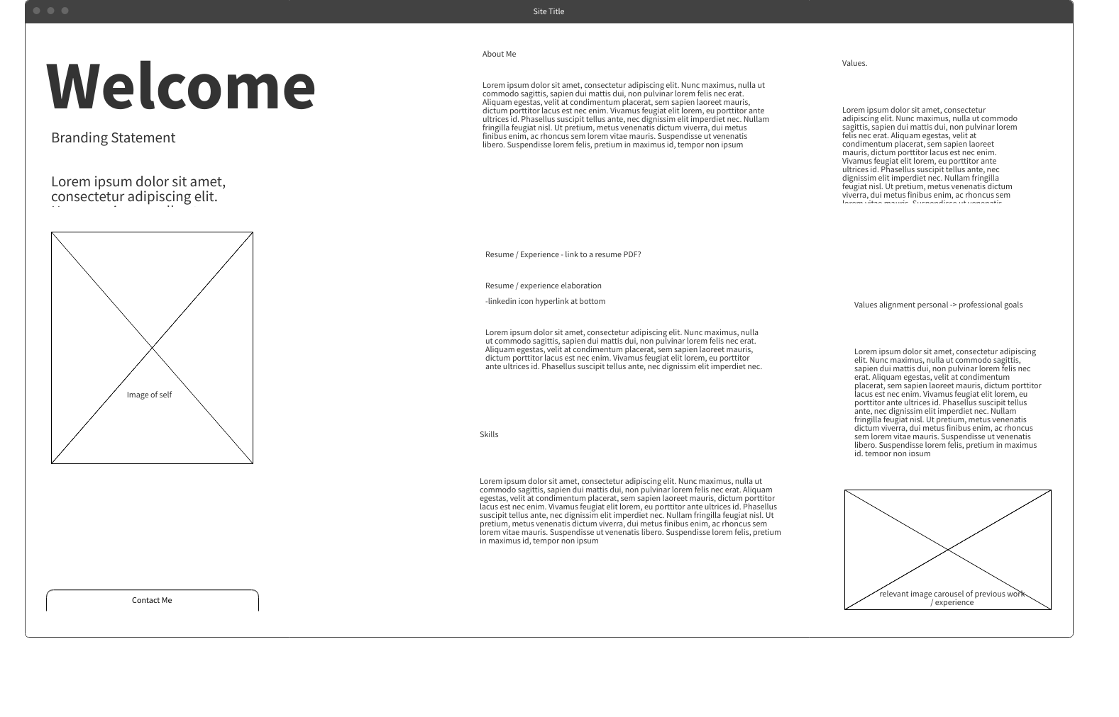

Slide 3
